Slide 1

Comparison of OpenMPI Algorithms for Collective Operations Gaia Alessio

Slide 2


Broadcast
Broadcast algorithms enable the distribution of a message from a source process to all other processes within the communicator.
Different algorithms vary in communication topology and data transmission approach.
Four distinct algorithms were chosen: basic linear, chain, binary tree, and knomial tree.

Slide 3

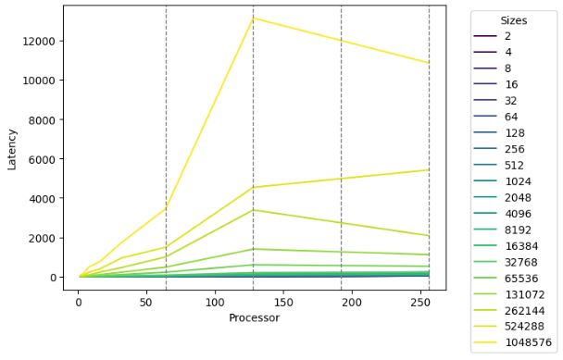
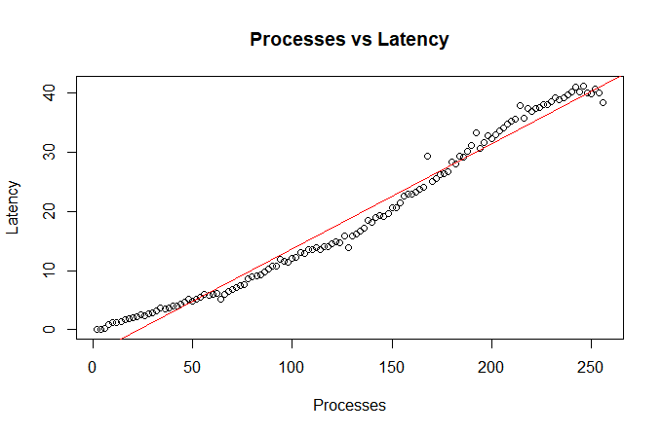
Basic linear
y = −4.055 + 0.177×processes

Slide 4
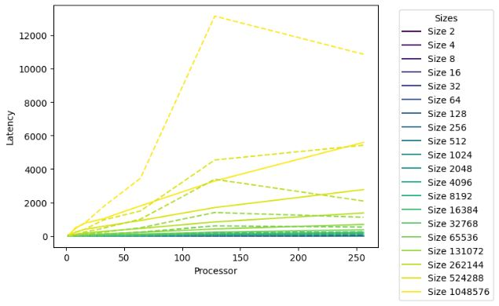
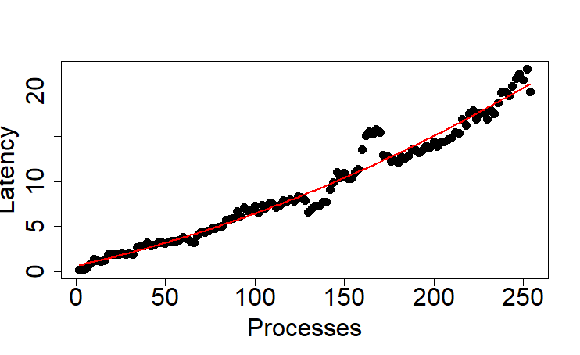
Chain
y = 6.443 e⁻¹ + 4.416 e⁻² processes + 1.392e⁻⁴ processes²

Slide 5
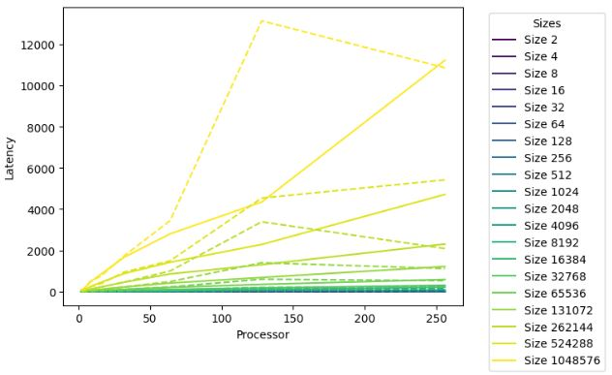
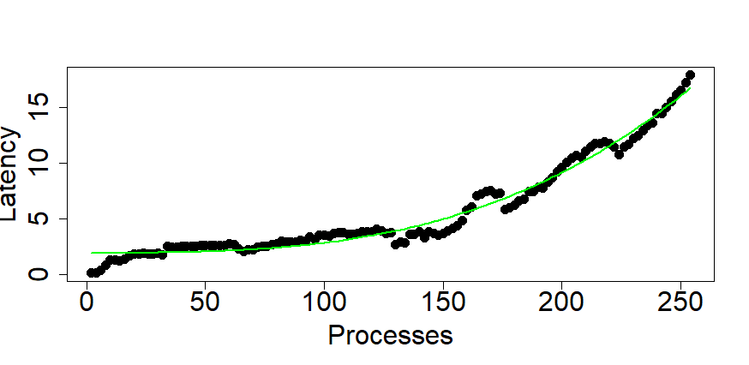
Binary tree
y = 1,957 + 8,99 e⁻² processes³

Slide 6
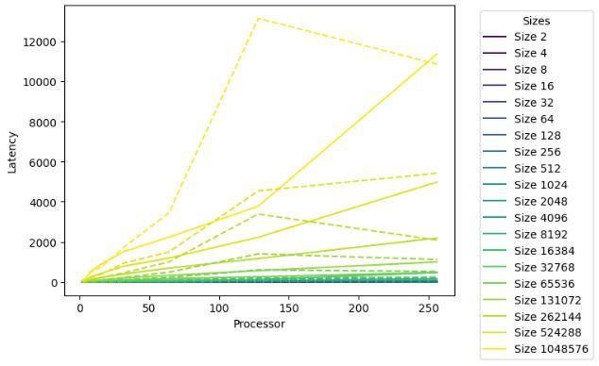
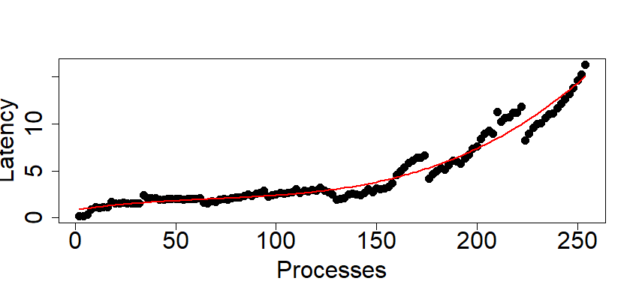
Binomial tree
y = 8.297e⁻¹ + 3.261e⁻² processes - 3.403 e⁻⁴ processes² + 1.704 e⁻⁶
processes³

Slide 7
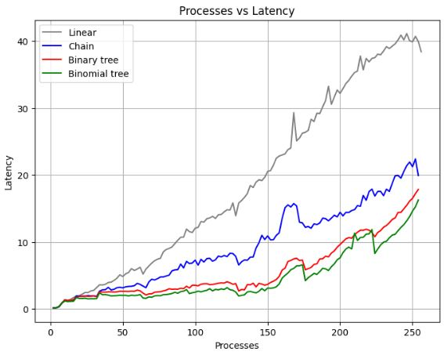
Comparison

Slide 8
Scatter
Scatter is an operation involving the distribution of data from a source process to all other participating processes. This process divides a message into parts and sends it to different processes, each of which receives a specific portion of the message, facilitating the parallelization of complex tasks and improving overall performance.
Four different algorithms were used: ignore, basic linear, binomial, and non-blocking linear.

Slide 9
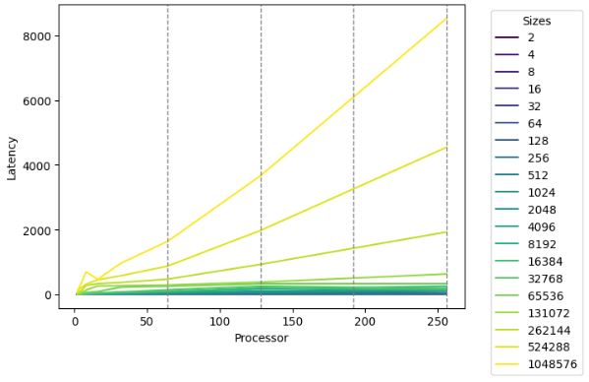
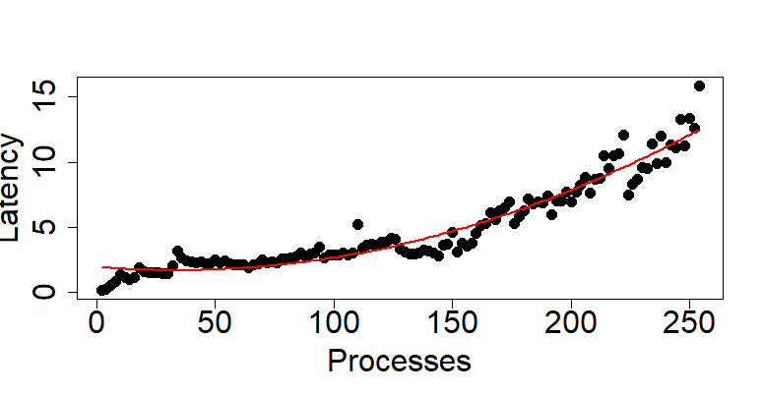
Ignore
y = 1.937 - 1.493 e⁻² processes + 2.223 processes²+ 4.640 processes³

Slide 10
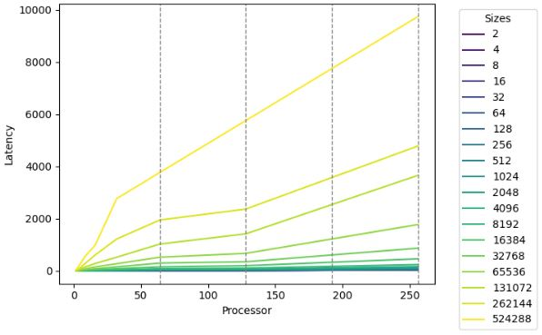
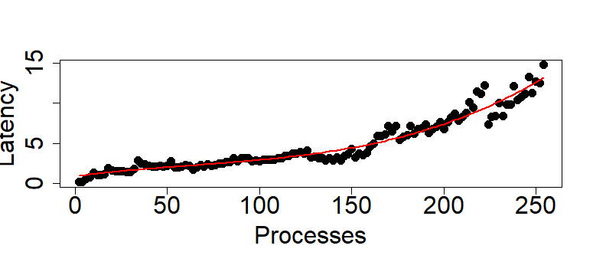
Basic linear
y = 8.708 e⁻¹ + 3.008 e⁻² processes + 1.009 e⁻⁶ processes³

Slide 11
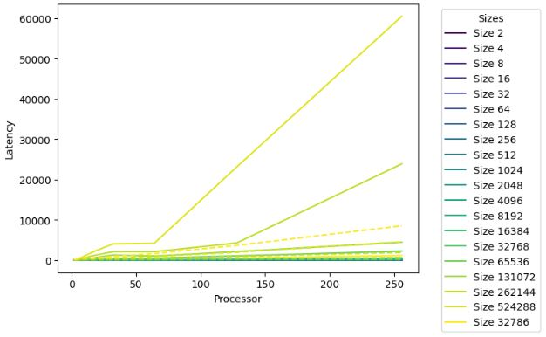
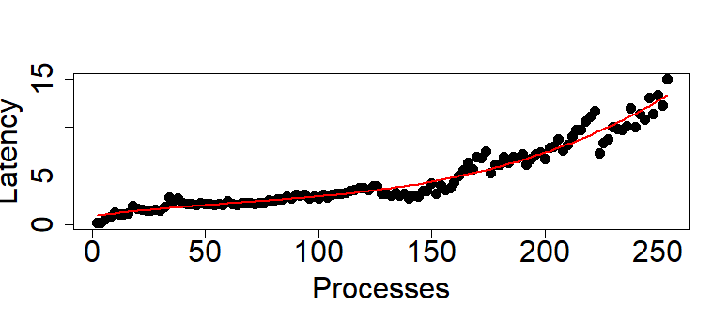
Binomial
y = 8.705 e⁻¹ + 3.060 e⁻² processes + 1.135 e⁻⁶ processes³

Slide 12
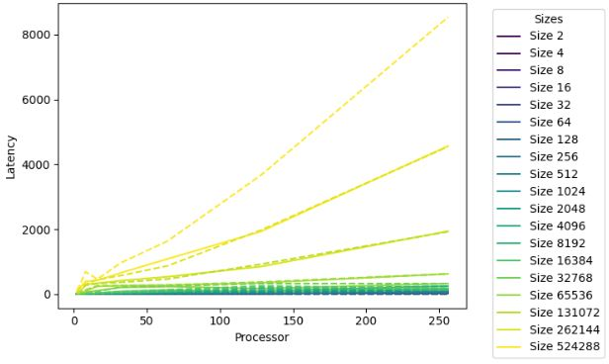
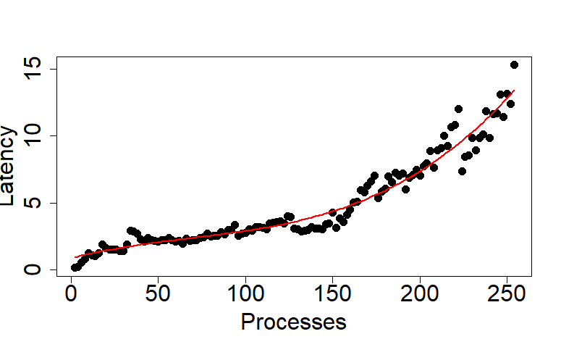
Non blocking linear
y = 8.753 e⁻¹ + 3.324 e⁻² processes + 1.247 e⁻⁶ processes³

Slide 13
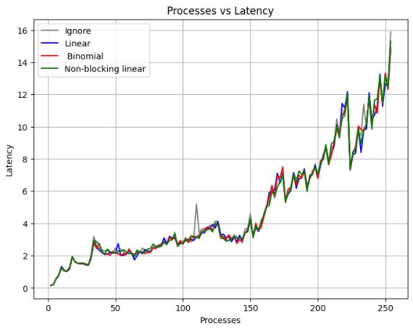
Comparison

